Slide 1

Machine Learning
Identifying Key Factors Influencing Income Levels for U.S. Policy Interventions
TXC

Slide 2





Problem Statement
Analyze the key factors that determine whether an individual in the United States earns more than $50,000 per year. By understanding which factors most influence income levels, policymakers can design more effective programs that target specific groups in need of support.
The project will use cluster analysis to segment the population based on their education, work, and demographic characteristics, identifying different groups and determining the most effective policy interventions for each.
The primary beneficiary of this research is the U.S. government, specifically agencies such as the Department of Labor, the Department of Education, the Congressional Budget Office, and state and local workforce boards.
The Dataset
Income Evaluation dataset, derived from the 1994 U.S. Census (32,561 records with 15 features)
Project’s
Goal
Target Variable: income – indicate income class (<=50K or >50K)
Demographic Attributes
age
Sex
marital-status
Race
native-country
Educational
Attributes
i. education – Highest level of education
ii. education-num – Number of years of education
Employment
Attributes
i. workclass – Type of employer
ii. occupation – Job type
iii. hours-per-week
iv. fnlwgt –weight
Financial
Attributes
i. capital-gain – Profit from capital investments
ii. capital-loss – Loss from capital investments
Partner
Institution

Slide 3







Exploratory Data Analysis
Explored variable distributions and relationships with income level, to uncover initial patterns and detect data quality issues.
Feature Engineering
Encoded categorical variables, scaled numerical ones, and removed redundant or highly correlated features.
Modeling (Classification)
Built and compared results from Logistic Regression, Random Forest, and XGBoost models to predict income class and evaluate feature importance.
Machine Learning Process Overview
Clustering
Applied K-Means on selected features and SHAP values to segment the population into policy-relevant groups.
Our focus for the presentation
Interpretation of Results and Recommendations
Proposed targeted educational policies based on cluster needs to reduce income disparities effectively.

Slide 4
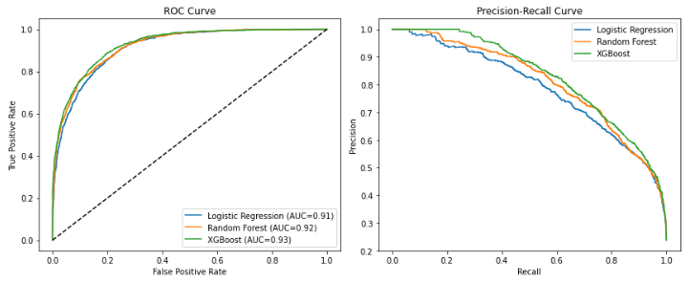
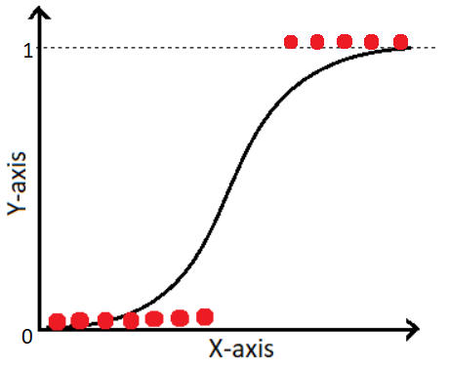

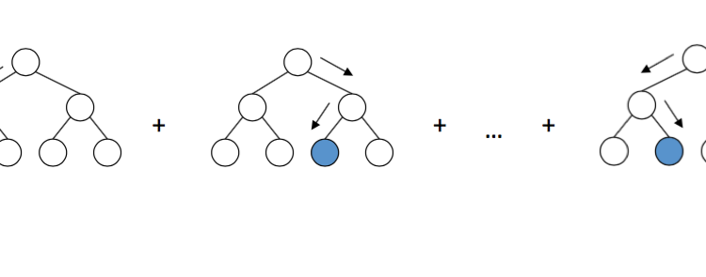
Modeling (Classification) | XGBoost had an overall better performance given higher accuracy and F1-score
Classification models implemented
Comparison of results
Target Variable: income – indicate income class (<=50K or >50K)
Logistic Regression
Used as a baseline model due to its simplicity and interpretability in binary classification tasks.
Random Forest
Selected for its robustness and ability to handle feature interactions; optimized through hyperparameter tuning using grid search.
XGBoost
Chosen for its high predictive power and efficiency on structured data; underwent hyperparameter tuning via random search.
Model | Accuracy | F1-Score | Precision | Recall | AUC-ROC
Logistic Reg. | 0.859 | 0.675 | 0.750 | 0.613 | 0.914
Random Forest | 0.869 | 0.695 | 0.779 | 0.628 | 0.921
XGBoost | 0.876 | 0.710 | 0.798 | 0.640 | 0.928

Slide 5
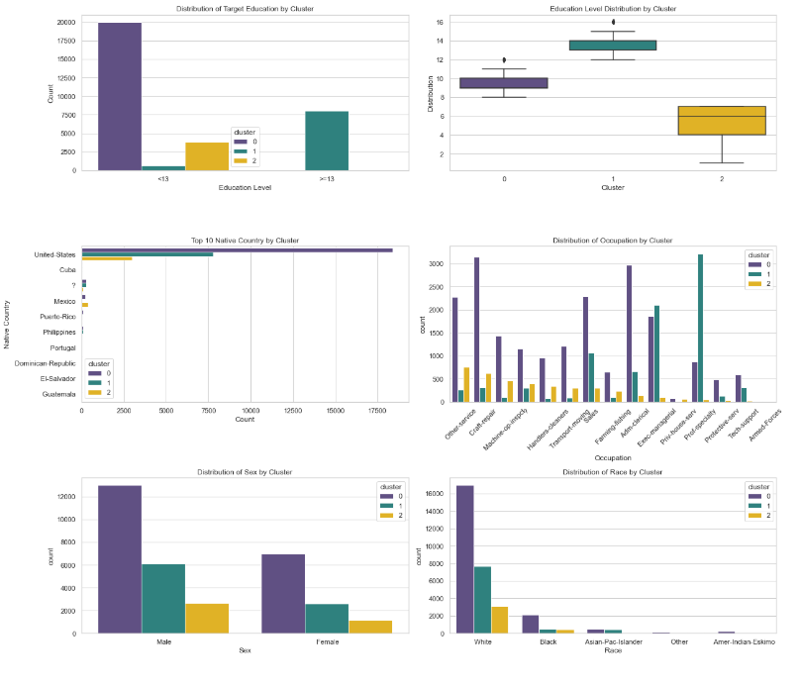
Clustering | K-Means clustering reveals clear education-based segments to guide targeted policy action
Process
Clusters
Classification model results and SHAP analysis highlighted education as a key income driver with a clear linear relationship, guiding our decision to segment the population using clustering.
Clustering was based on educational level, occupation, and key demographic attributes, including native country, sex, and race.
We applied K-Means clustering with 3 clusters (optimal number based on the Elbow method), achieving a silhouette score of 0.65.
“Yellow”: Lowest-educated group in manual and unskilled labor (Target group, 1st priority) - requires urgent basic education and vocational support.
“Purple”: Mid-educated workforce in manual and service jobs (Target group, 2nd priority) —targeted for second-wave upskilling and community college access.
“Green”: Highly educated professionals in specialized roles—no immediate policy intervention needed.
*13 years: Holds bachelor degree

Slide 6

Recommendation | U.S. Government should address income gaps through a two-wave educational policy strategy
1st Wave (Priority program)
“Yellow” Cluster (2) – 11.7% of the sample
2nd Wave (Target program)
“Purple” Cluster (0) – 60.3% of the sample
Program
Focus
Basic education completion (e.g., GED, adult literacy), vocational training
Upskilling through community college access, vocational-to-degree bridge programs
Responsible
Org.
Department of Education, Local School Districts, Community Centers
Department of Labor, Community Colleges, Workforce Development Boards
Avg. time for
Implementation
2-3 years
3-4 years
Monitoring
Method
Track high school completion rates, GED certification rates, vocational training enrollment
Monitor enrollment in bridge programs, community college graduation rates, and upskilling certifications
Expected
Results
Higher literacy and education attainment, increased entry into skilled labor, income uplift
Improved access to skilled job markets, increased education level, and income mobility

